Slide 1


CAPSTONE DESIGN 02 PRESENTATION
NETWOD
Team 14
Jeonghoon, Kim 20146235 (Presenter)
Sungjae, Min 20145223
Sungju, Go 20165245

Slide 2
01 Weekly plan
02 Progress
INDEX
03 Problems & Solutions
04 Next week plan
Q & A

Slide 3
1 ”
Weekly plan

Slide 4

01
Weekly plan
Plan
02
03
 | 2nd | 3rd | 4th | 5th | 6th | M I D D E M O
Jeonghoon,Kim | Defining data structure for database | Basic android UI design& develop |  | Basic android app function design&develop | Integrating modules & Test
Sungjae,Min | Making excel sheet template& Data collection | Implementation of excel parsing module | Implementation of App database
Sungju,Go |  | WOD data collection& data store to data structure | Implementation of WOD generating module
 | 9th | 10th | 11th | 12th | 13th | F I N D E M O
Jeonghoon,Kim | Community android UI design& develop |  | Community android app function design & develop |  | Integrating modules& test
Sungjae,Min | Build community server system |  | DB system implementation & Build data transfer module
Sungju,Go | Implementation of statistical function
04

Slide 5
2”
Progress

Slide 6
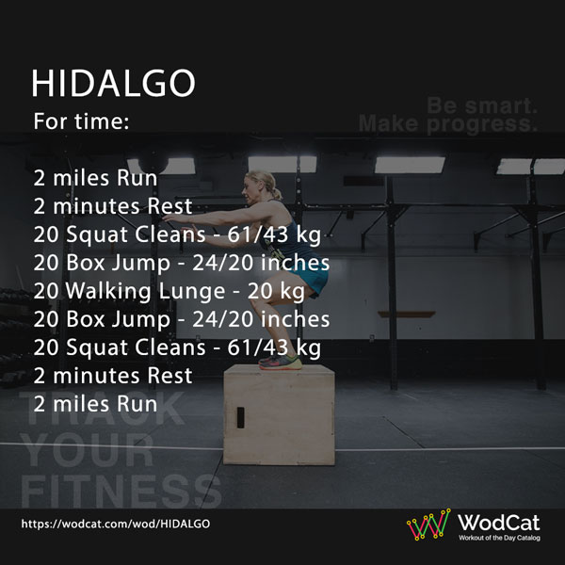
02
Progress
Progress
01
Data collection – 3 categories
03
04
Type
Movement
Equipment ex)Box jump :Box Double under : Jump rope

Slide 7
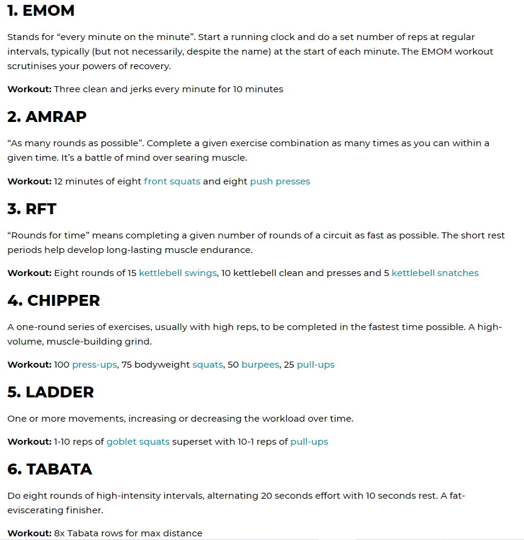
02
Progress
Progress
01
03
Data collection : WOD types
04

Slide 8
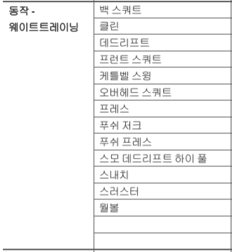
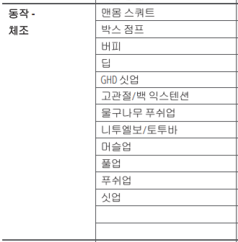
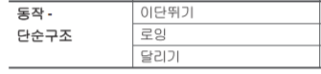
02
Progress
Progress
01
03
Data collection : movement
04

Slide 9
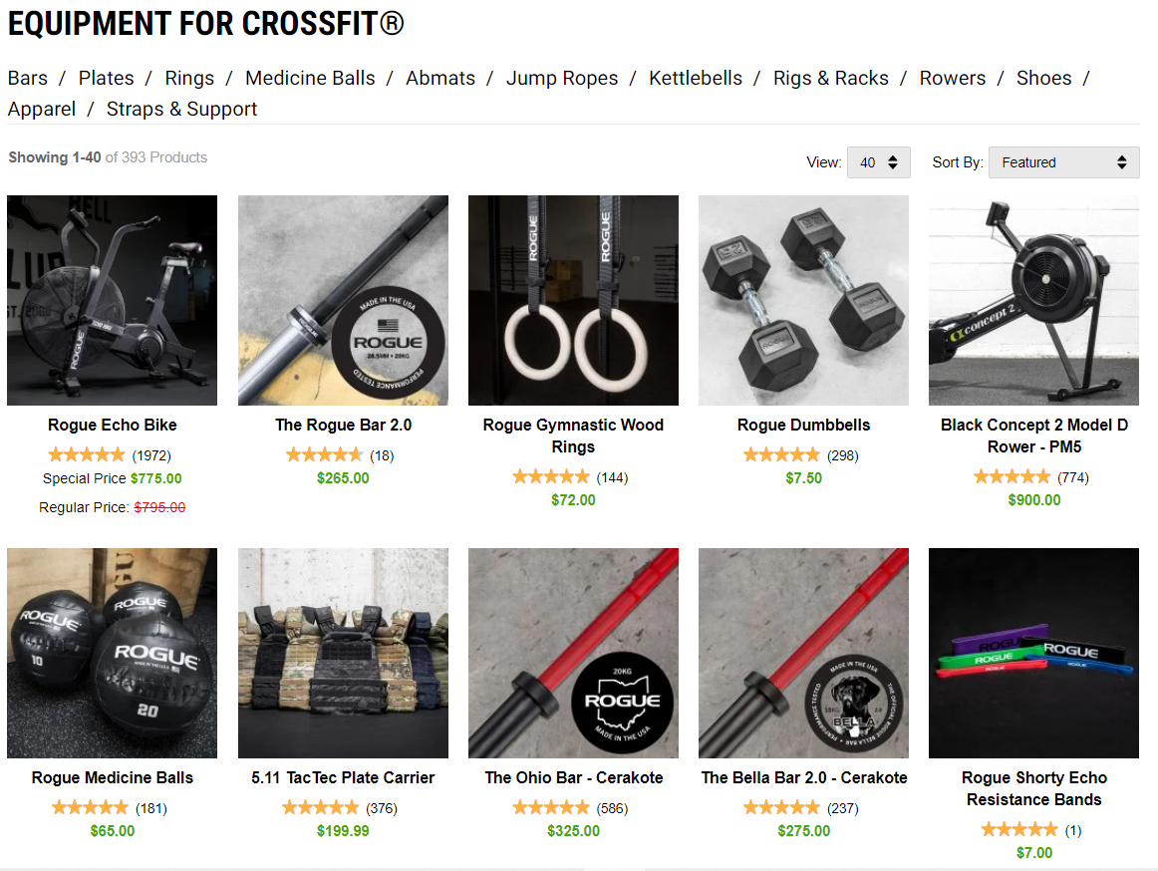
02
Progress
Progress
01
03
Data collection : equipment
04

Slide 10
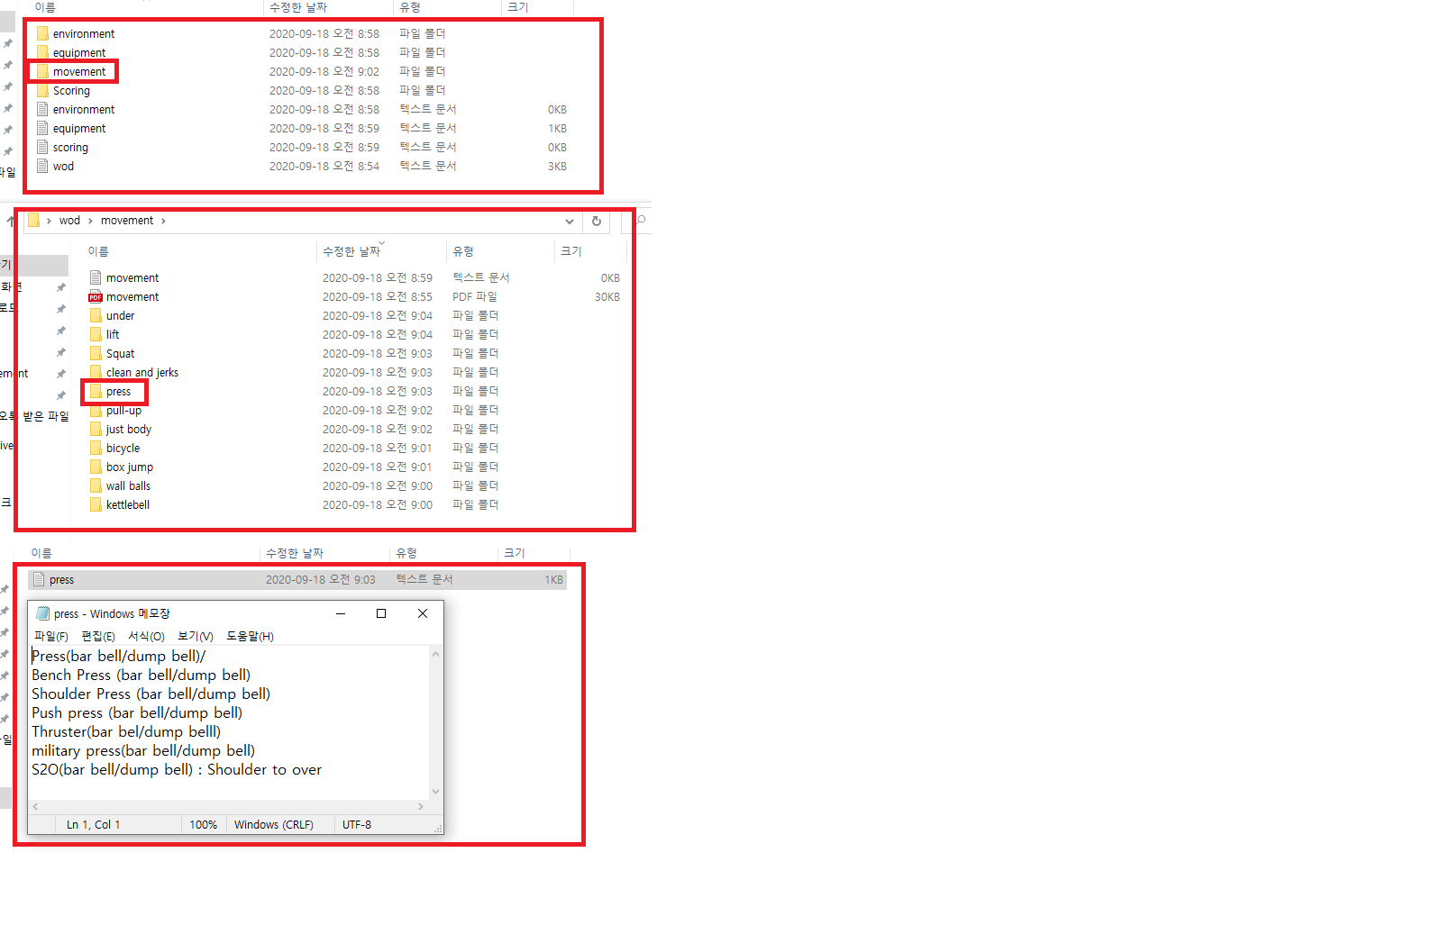
02
Progress
Progress
01
03
Data collection
04

Slide 11
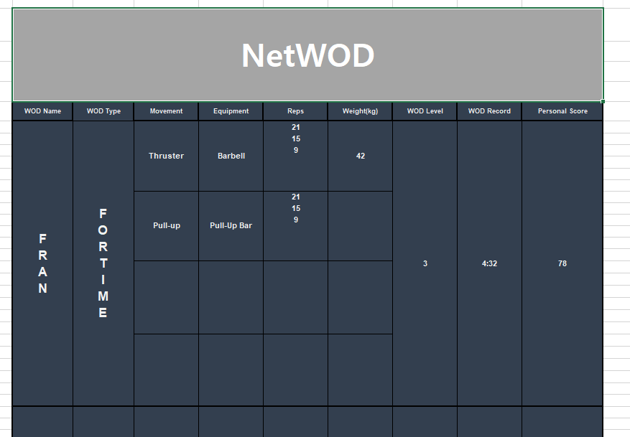
02
Progress
Progress
01
03
User record Excel sheet template
04

Slide 12
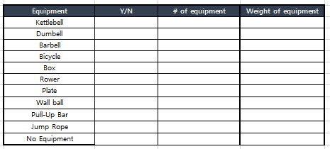
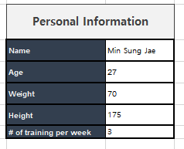
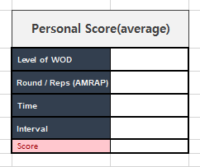
02
Progress
Progress
01
03
User record Excel sheet template
04

Slide 13
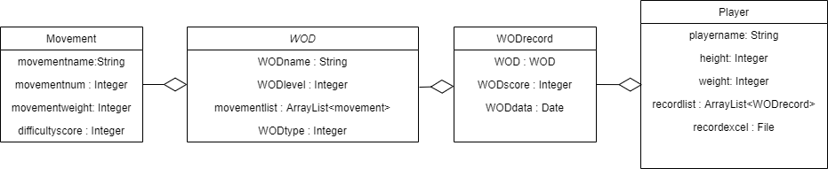
02
Progress
Progress
01
03
Defining data structure
04

Slide 14
3”
Problems & Solutions

Slide 15
03
Problems
Progress
01
02
04
There was no problem this week.

Slide 16
4”
Next week plan

Slide 17
04
Next
Next
01
02
 | 2nd | 3rd | 4th | 5th | 6th | M I D D E M O
Jeonghoon,Kim | Defining data structure for database | Basic android UI design& develop |  | Basic android app function design&develop | Integrating modules & Test
Sungjae,Min | Making excel sheet template& Data collection | Implementation of excel parsing module | Implementation of App database
Sungju,Go |  | WOD data collection& data store to data structure | Implementation of WOD generating module
 | 9th | 10th | 11th | 12th | 13th | F I N D E M O
Jeonghoon,Kim | Community android UI design& develop |  | Community android app function design & develop |  | Integrating modules& test
Sungjae,Min | Build community server system |  | DB system implementation & Build data transfer module
Sungju,Go | Implementation of statistical function
03

Slide 18

Thank You!

